Slide 1
Distributed Reinforcement Learning
In Dymaic Edge Computing Environemet
①
②
③
Distributedand Collective Deep Reinforcement Learning for Computation Offloading:A Practical Perspective
Joint Computation Offloading and Resource Allocation in Multi-Edge Smart Communities With Personalized Federated Deep Reinforcement Learning
Distributed Resource Scheduling for Large-Scale MEC Systems A Multiagent Ensemble Deep Reinforcement Learning With imitation Acceleration
⑤
④
A Distributed Deep Reinforcement Learning Technique for Application Placement in Edge and Fog Computing_Environments
Dynamic Scheduling for Stochastic Edge-Cloud Computing Environments Using A3C Learning and Residual Recurrent Neural Networks
CPS Computational Learning Laboratory

Slide 2

②
Joint Computation Offloading and Resource Allocation in Multi-Edge Smart Communities With Personalized Federated Deep Reinforcement Learning
Resource Allocation
Computation Offloading
①
Joint Computation Offloading and Resource Allocation
③
Distributedand Collective Deep Reinforcement Learning for Computation Offloading:A Practical Perspective
Distributed Resource Scheduling for Large-Scale MEC Systems A Multiagent Ensemble Deep Reinforcement Learning With imitation Acceleration
Computation Offloading
DAG graph represents tasks
Resource Scheduling
Task Migration
⑤
④
A Distributed Deep Reinforcement Learning Technique for Application Placement in Edge and Fog Computing Environments
Dynamic Scheduling for Stochastic Edge-Cloud Computing Environments Using A3C Learning and Residual Recurrent Neural Networks
Application Placement
Resource Schedule and Task Migration
CPS Computational Learning Laboratory

Slide 3

Paper 1
Distributed and Collective Deep Reinforcement Learning
for Computation Offloading: A Practical Perspective
Xiaoyu Qiu, Weikun Zhang, Wuhui Chen, Zibin Zheng
Published in: IEEE TRANSACTIONS ON PARALLEL AND DISTRIBUTED SYSTEMS
Published Time: 2021
CPS Computational Learning Laboratory

Slide 4
01
Problem Description
02
Method Design
03
Experiment Results
Contents
04
Conclusion
CPS Computational Learning Laboratory

Slide 5
01
Problem Description
02
Method Design
03
Experiment Results
Contents
04
Conclusion
CPS Computational Learning Laboratory

Slide 6
Problem Description
Traditional approaches (e.g., linear programming and game-theory methods) for computation offloading mainly focus on the immediate performance, potentially leading to performance degradation in the long run.
Deep reinforcement learning (DRL) provide alternative methods, which focus on maximizing the cumulative reward. Nonetheless, there exists a large gap to deploy real DRL applications in MEC.
Training a well-performed DRL agent typically requires data with large quantities and high diversity,
DRL training is usually accompanied by huge costs(also known as exploration costs) caused by trial-and-error.
CPS Computational Learning Laboratory

Slide 7
01
Problem Description
02
Method Design
03
Experiment Results
Contents
04
Conclusion
CPS Computational Learning Laboratory

Slide 8
Method Design
To address the challenges, it is natural to consider sharing experiences and spreading the costs of trial-and-error over multiple MEC environments, and thereby achieving a larger number and greater diversity of experiences and lower exploration costs.
A Distributed and Collective DRL-based algorithm calles DC-DRL, which can adaptively make the offloading and channel allocation decisions.
An updating method called adaptive n-step learning, which can improve training efficiency without suffering from the high variance caused by distributed training.
Combining the advantages of deep neuroevolution and policy gradient to maximize the utilization of multiple environments and prevent the premature convergence.
CPS Computational Learning Laboratory

Slide 9
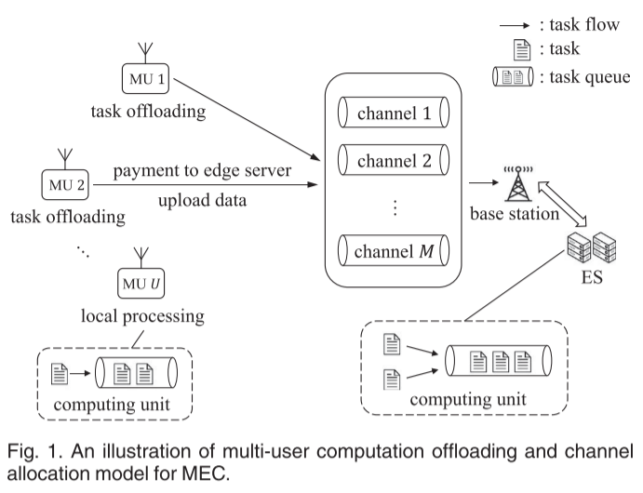
Method Design
MU: Mobile User
ES: Edge Computing
MEC: Mobile Edge Computing
CPS Computational Learning Laboratory

Slide 10
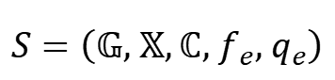
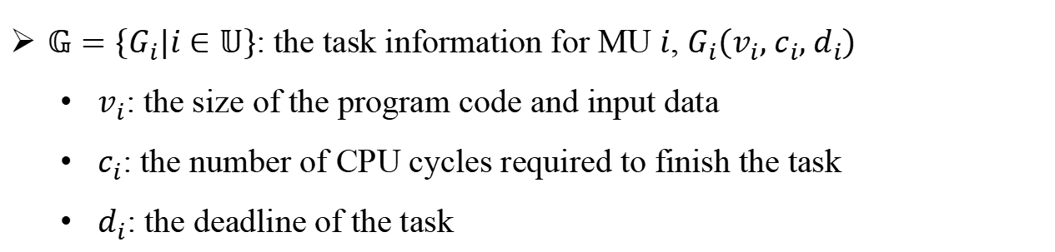
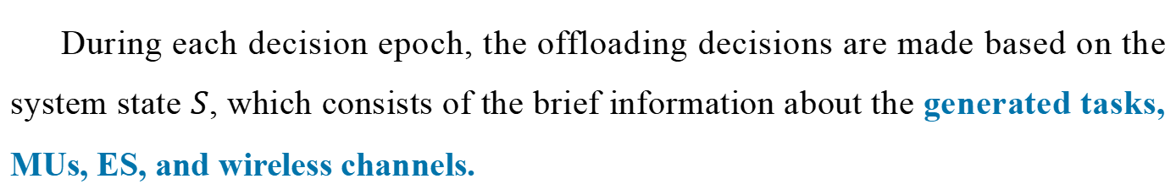
Method Design
During each decision epoch, the offloading decisions are made based on the system state $S$, which consists of the brief information about the generated tasks, MUs, ES, and wireless channels.
$$S=\left(𝔾, 𝕏,ℂ, f_{e}, q_{e}\right)$$
$𝔾=\left\{G_{i}|i∈𝕌\right\}$: the task information for MU $i$, $G_{i}\left(v_{i}, c_{i}, d_{i}\right)$
$v_{i}$: the size of the program code and input data
$c_{i}$: the number of CPU cycles required to finish the task
$d_{i}$: the deadline of the task
CPS Computational Learning Laboratory

Slide 11
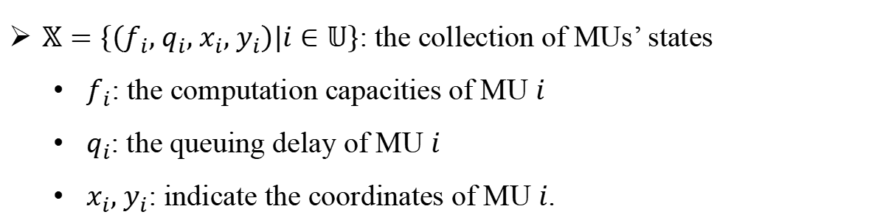
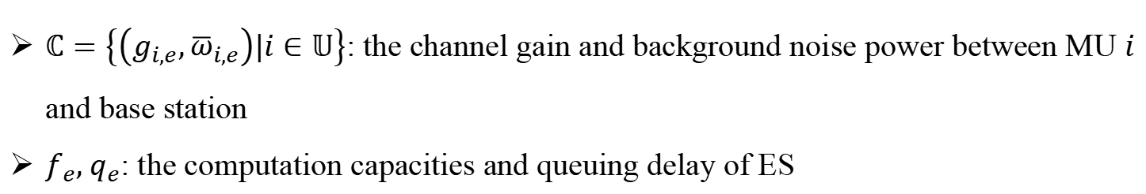
Method Design
$𝕏=\left\{\left(f_{i}, q_{i}, x_{i}, y_{i}\right)|i∈𝕌\right\}$: the collection of MUs’ states
$f_{i}$: the computation capacities of MU $i$
$q_{i}$: the queuing delay of MU $i$
$x_{i}, y_{i}$: indicate the coordinates of MU $i$.
$ℂ=\left\{\left(g_{i,e},{\overline{ω}}_{i,e}\right)|i∈𝕌\right\}$: the channel gain and background noise power between MU $i$ and base station
$f_{e}, q_{e}$: the computation capacities and queuing delay of ES
CPS Computational Learning Laboratory

Slide 12
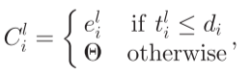
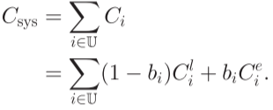
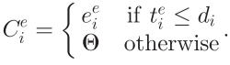
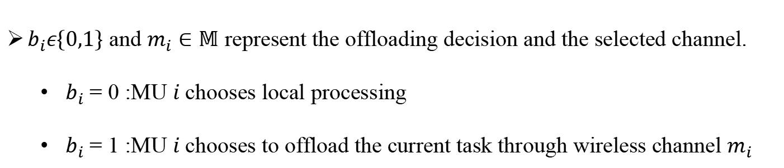
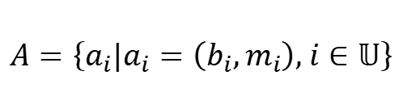
Method Design
$$A=\left\{a_{i}|a_{i}=\left(b_{i},m_{i}\right), i∈𝕌\right\}$$
$b_{i}ε\left\{0,1\right\}$ and $m_{i}∈𝕄$ represent the offloading decision and the selected channel.
$b_{i}$ = 0 :MU $i$ chooses local processing
$b_{i}$ = 1 :MU $i$ chooses to offload the current task through wireless channel $m_{i}$
Reward = -Cost
the cost of local processing:
the cost of edge computing:
CPS Computational Learning Laboratory

Slide 13
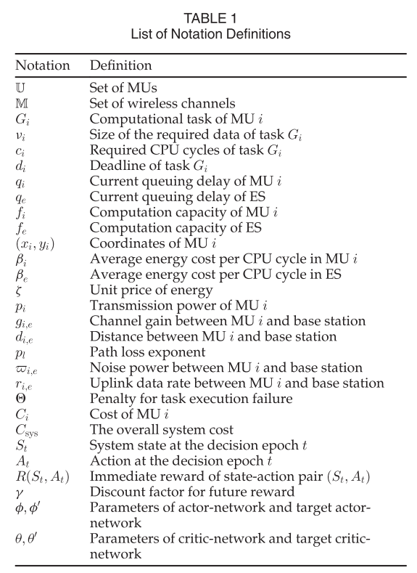
Method Design
CPS Computational Learning Laboratory

Slide 14
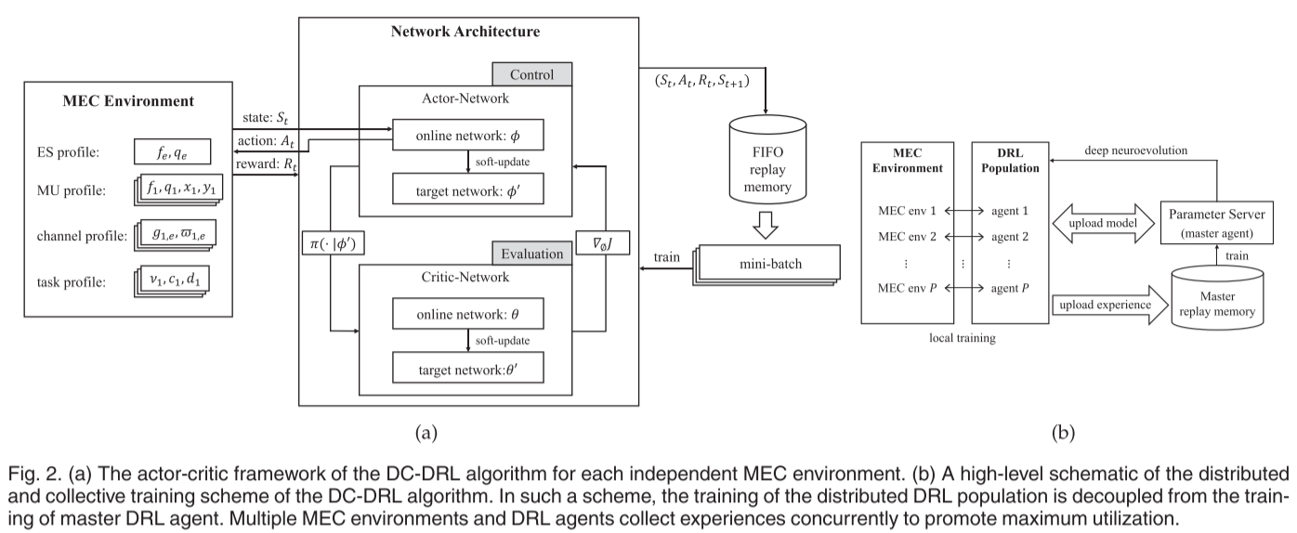
Method Design
CPS Computational Learning Laboratory

Slide 15
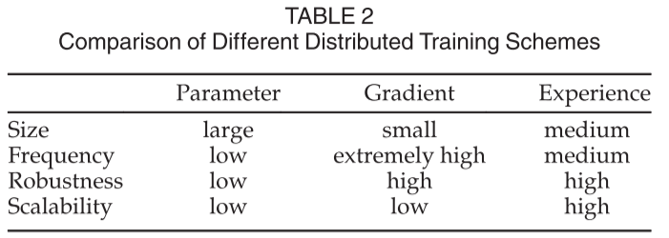
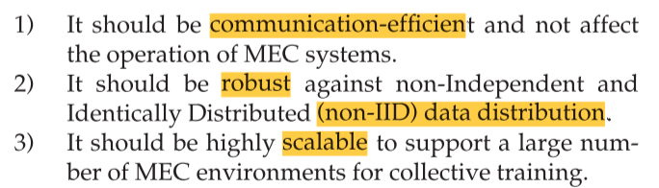
Method Design
Requirement:
CPS Computational Learning Laboratory

Slide 16
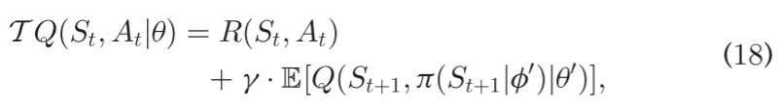
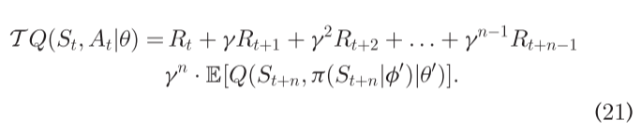
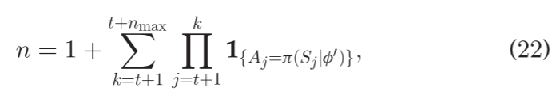
Method Design
Adaptive N-Step Learning
However, it inevitably leads to high bias and low efficiency in the early stages of training
The selected truncated trajectories are collected with the previous policy, which may greatly deviate from the policy to be updated
We propose a method that can dynamically adjust the value of n based on the policy deviation, namely adaptive n-step learning
CPS Computational Learning Laboratory

Slide 17
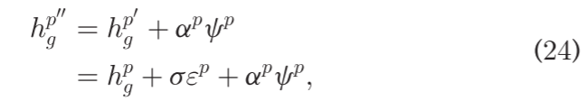
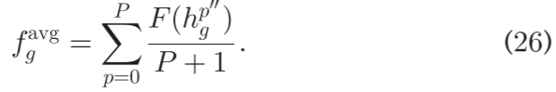
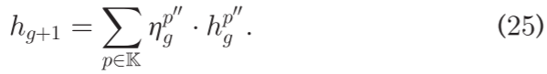
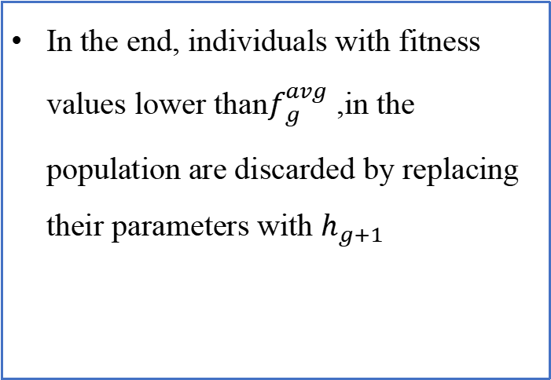
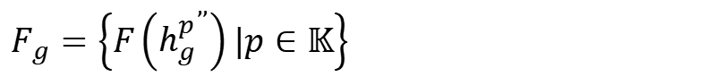
Method Design
Combining Deep Neuroevolution With Policy Gradient
We combine the advantages of deep neuroevolution and policy gradient, which greatly improves the utilization of multiple environments and prevents the premature convergence.
In the end, individuals with fitness values lower than$f_{g}^{avg}$ ,in the population are discarded by replacing their parameters with $h_{g+1}$
$$F_{g}=\left\{F\left({h_{g}^{p}}^{’’}\right)|p∈𝕂\right\}$$
CPS Computational Learning Laboratory

Slide 18
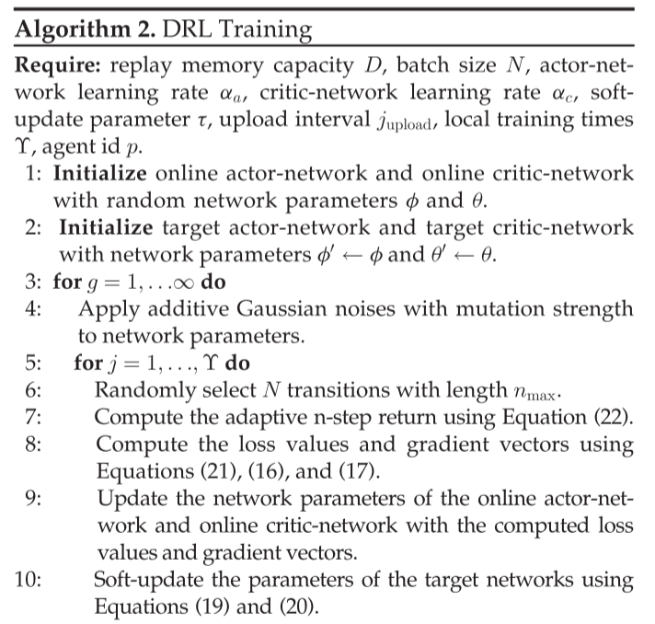
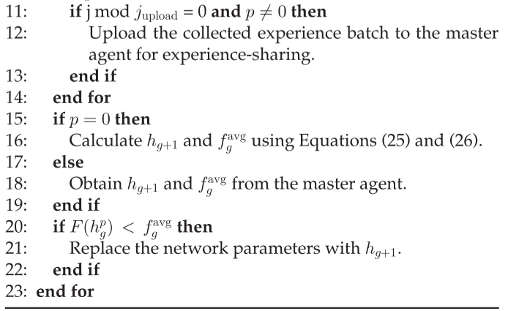
Method Design
CPS Computational Learning Laboratory

Slide 19
01
Problem Description
02
Method Design
03
Experiment Results
Contents
04
Conclusion
CPS Computational Learning Laboratory

Slide 20
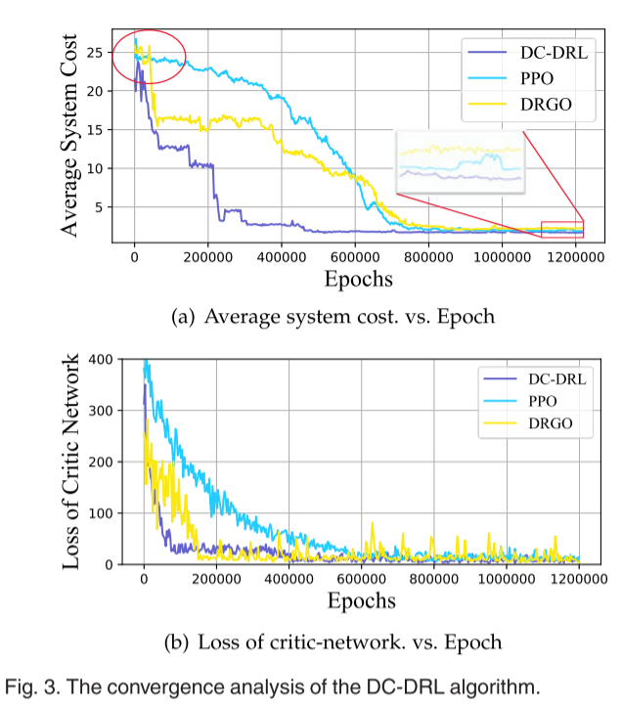
Experiment Results
Convergence Analysis
CPS Computational Learning Laboratory

Slide 21
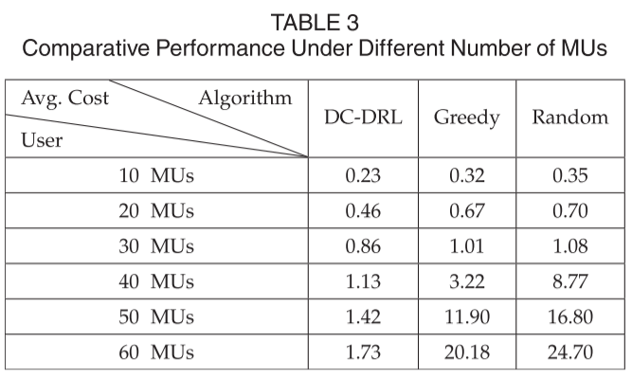
Experiment Results
Performance Under Different Numbers of MUs
CPS Computational Learning Laboratory

Slide 22
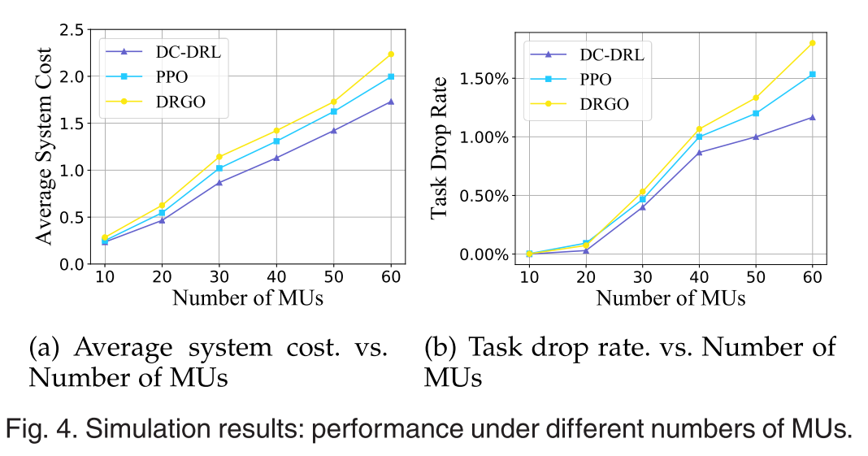
Experiment Results
Performance Under Different Numbers of MUs
CPS Computational Learning Laboratory

Slide 23
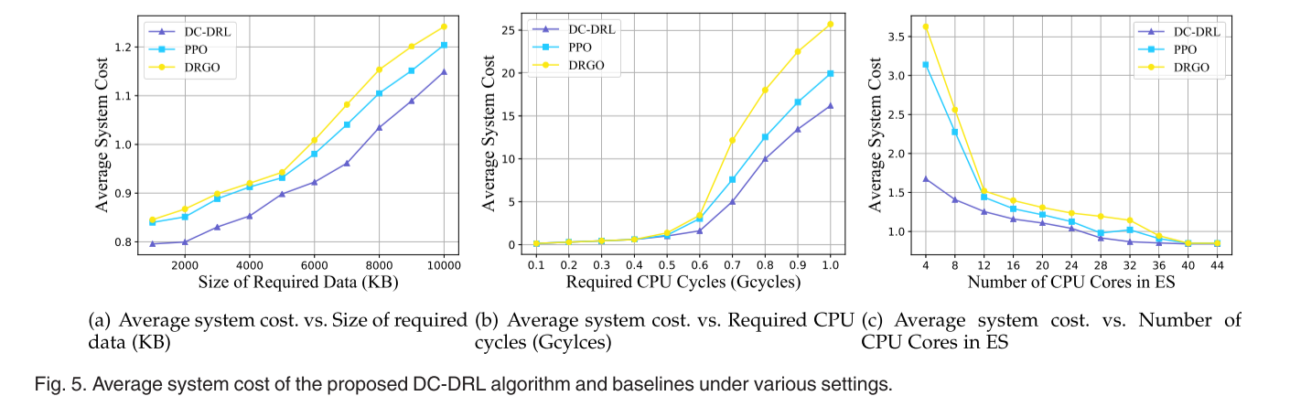
Experiment Results
Performance Under Different Task
CPS Computational Learning Laboratory

Slide 24
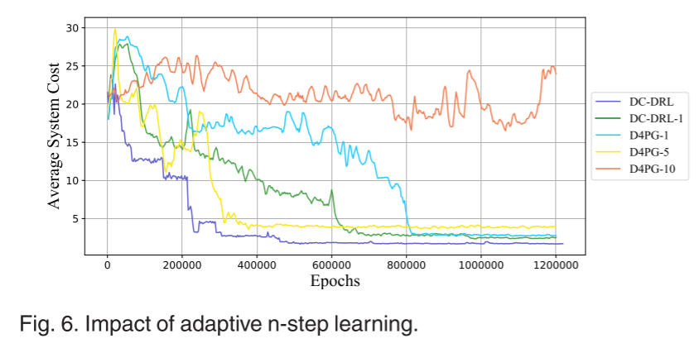
Experiment Results
Impact of Adaptive N-Step Learning
CPS Computational Learning Laboratory

Slide 25
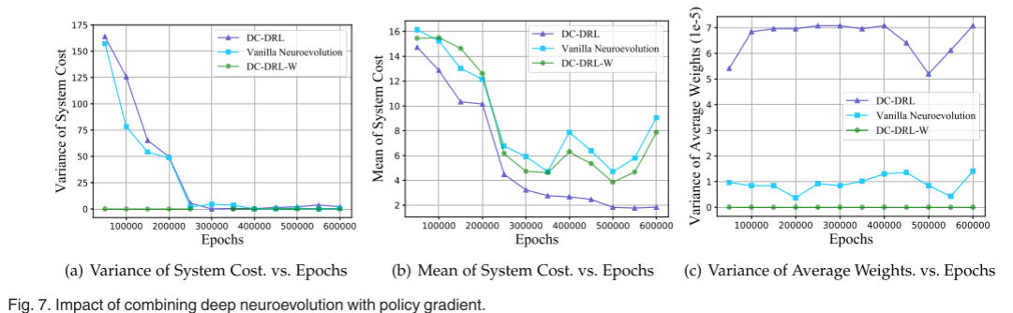
Experiment Results
Impact of Combining Deep Neuroevolution With Policy Gradient
CPS Computational Learning Laboratory

Slide 26
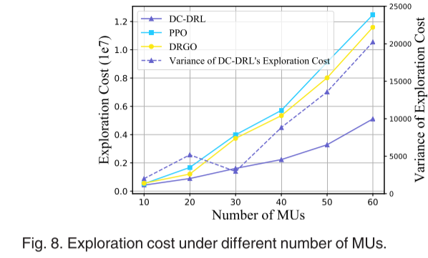
Experiment Results
Performance With Respect to Exploration Cost
CPS Computational Learning Laboratory

Slide 27
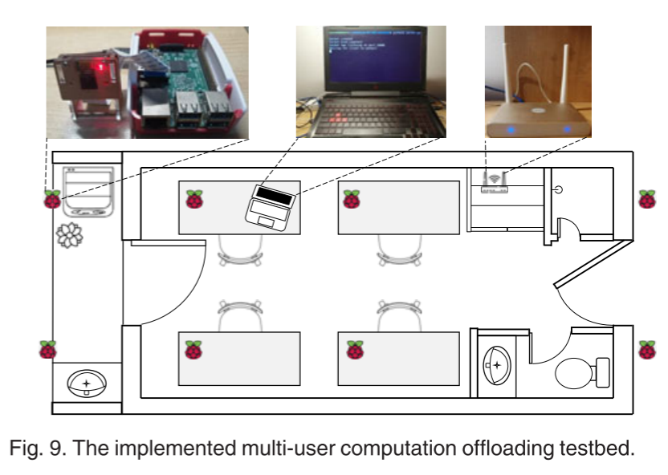
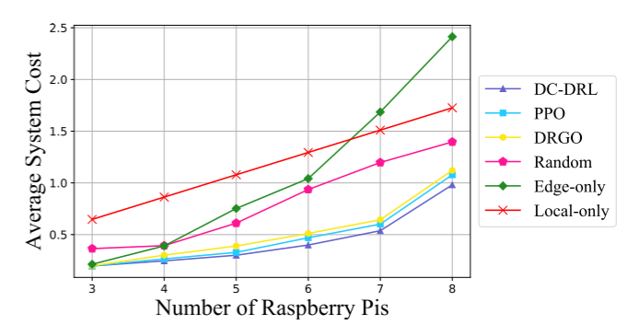
Experiment Results
Experiments in Real-World Scenarios
CPS Computational Learning Laboratory

Slide 28
01
Problem Description
02
Method Design
03
Experiment Results
Contents
04
Conclusion
CPS Computational Learning Laboratory
CPS Computational Learning Laboratory
2
18

Slide 29
Conclusion
The DC-DRL algorithm can obtain knowledge beyond a single agent for higher performance and evenly spread the costs across multiple environments.
The adaptive n-step learning can improve the training efficiency without affecting the convergence stability.
The combination of deep neuroevolution and policy gradient can greatly thus reducing exploration costs and improving convergence effects.
CPS Computational Learning Laboratory

Slide 30
Paper 2
Joint Computation Offloading and Resource Allocation
in Multi-Edge Smart Communities With Personalized
Federated Deep Reinforcement Learning
Zheyi Chen, Bing Xiong, Xing Chen, Geyong Min, Jie Li
Publish Journal: IEEE TRANSACTIONS ON MOBILE COMPUTING
Published Time: 2024
CPS Computational Learning Laboratory

Slide 31
01
Problem Description
02
Method Design
03
Experiment Results
Contents
04
Conclusion
CPS Computational Learning Laboratory

Slide 32
01
Problem Description
02
Method Design
03
Experiment Results
Contents
04
Conclusion
CPS Computational Learning Laboratory

Slide 33
Problem Description
The methods based on rule, heuristics, and control theory need to rely on prior knowledge of systems to formulate proper policies.
DRL-Based Methods
Value-Based: Action space grows exponentially with the increasing number of EDs(End Devices). It degrades the accuracy of selecting actions and deviates policies from optimal performance.
Policy-Based: It tends to overestimate the Q-value function during the training process, which may cause large training fluctuations and the generated policies to easily fall into the local optimum.
Muti-agent: Some agents lack training samples, their training effects will be seriously restricted.
CPS Computational Learning Laboratory

Slide 34
01
Problem Description
02
Method Design
03
Experiment Results
Contents
04
Conclusion
CPS Computational Learning Laboratory

Slide 35
Method Design
The above methods can’t adapt to dynamic MEC environments changeable system states and personalized user demands.
We propose a novel Personalized Federated deep Reinforcement learning based computation Offloading and resource Allocation method (PFR-OA).
To relieve the negative impact of local updates on global model convergence, we design a new proximal term to improve the manner of only optimizing local Q-value loss functions in classic reinforcement learning.
We develop a new partial-greedy based participant selection mechanism to reduce the complexity of federated aggregation while endowing sufficient exploration.
CPS Computational Learning Laboratory

Slide 36
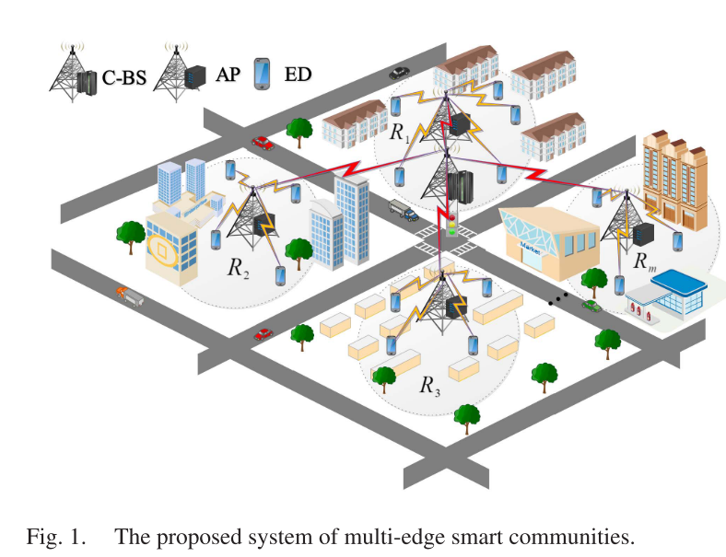
Method Design
C-BS: Central Base Station
AP: Access Point with an MEC server
ED: End Device
CPS Computational Learning Laboratory

Slide 37
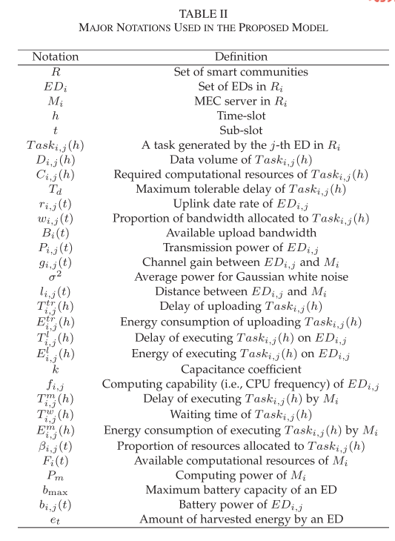
Method Design
CPS Computational Learning Laboratory

Slide 38
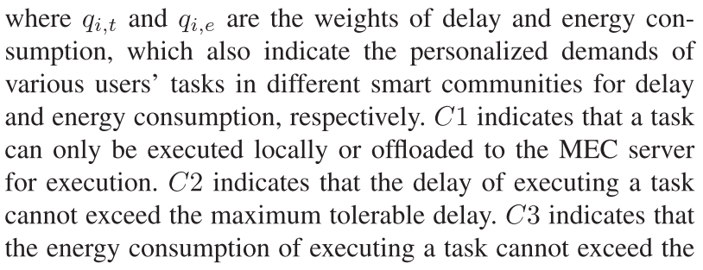
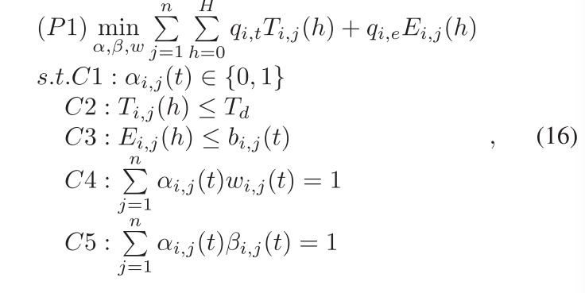
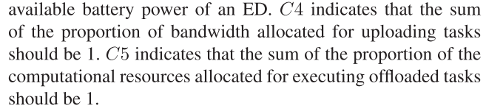
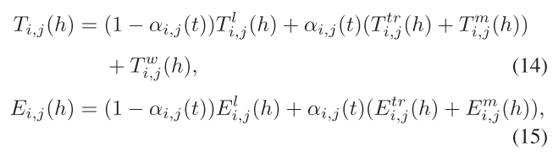
Method Design
Mobile-Edge Environment i:
CPS Computational Learning Laboratory

Slide 39
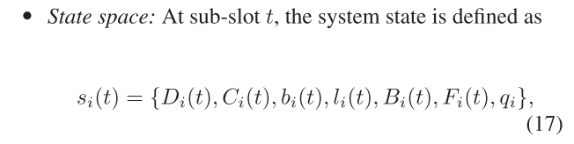
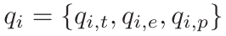
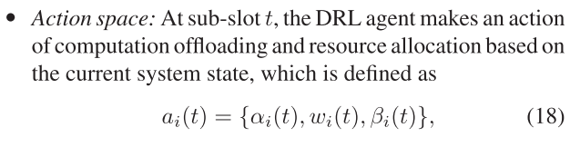
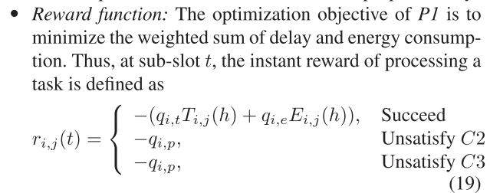
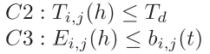
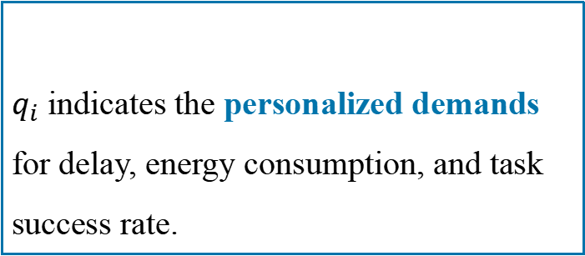
Method Design
$q_{i}$ indicates the personalized demands for delay, energy consumption, and task success rate.
CPS Computational Learning Laboratory

Slide 40
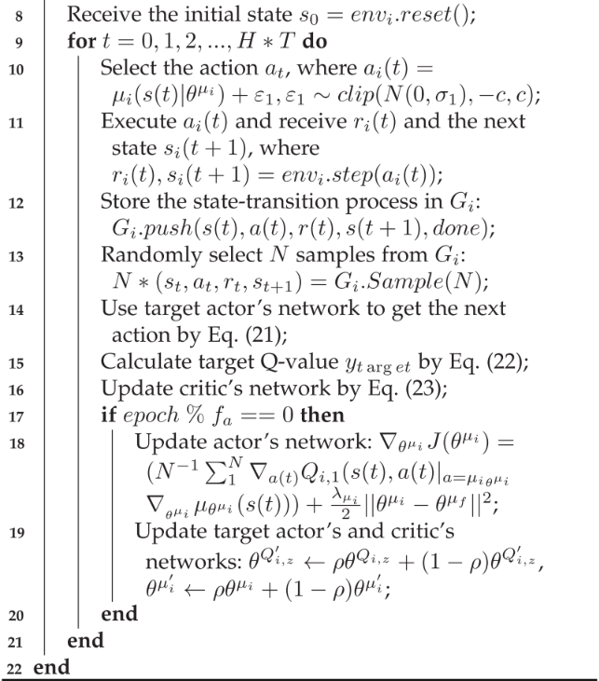
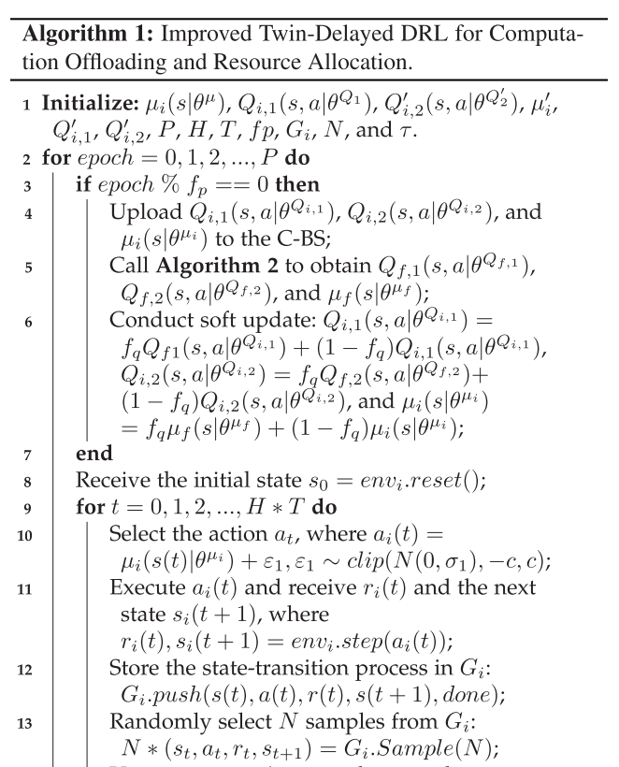
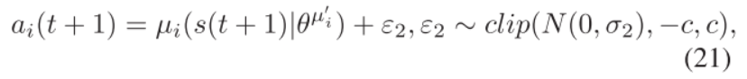
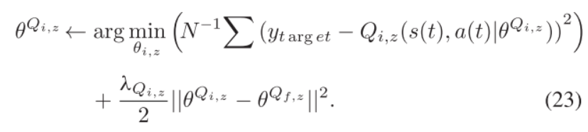
Method Design
Add a proximal term to the loss function
CPS Computational Learning Laboratory

Slide 41


Method Design
Partial-greedy based participant selection mechanism
CPS Computational Learning Laboratory

Slide 42
01
Problem Description
02
Method Design
03
Experiment Results
Contents
04
Conclusion
CPS Computational Learning Laboratory

Slide 43

Experiment Results
Hyperparameter Tuning
CPS Computational Learning Laboratory

Slide 44


Experiment Results
Convergence Comparison
CPS Computational Learning Laboratory

Slide 45

Experiment Results
Performance Comparison After Convergence
CPS Computational Learning Laboratory

Slide 46

Experiment Results
Performance Comparison With Various Required Computational Resources of Tasks
CPS Computational Learning Laboratory

Slide 47

Experiment Results
Performance Comparison With Various Network Band-widths ofa BS
CPS Computational Learning Laboratory

Slide 48

Experiment Results
Performance Comparison With Various Computing Capabilities of a MEC Server
CPS Computational Learning Laboratory

Slide 49


Experiment Results
Performance Comparison With Various Computing Capabilities of a MEC Server
CPS Computational Learning Laboratory

Slide 50
01
Problem Description
02
Method Design
03
Experiment Results
Contents
04
Conclusion
CPS Computational Learning Laboratory
CPS Computational Learning Laboratory
2
18

Slide 51
Conclusion
We first formulate the computation offloading and resource allocation in dynamic multi-edge smart community systems with personalized demands as a model-free DRL problem with multiple constraints.
We propose a novel PFR-OA that combines an improved twin-delayed DRL-based algorithm and a new personalized FL-based training framework to address the issues of action dispersion and inefficient model updates.
CPS Computational Learning Laboratory

Slide 52
Paper 3
Distributed Resource Scheduling for Large-ScaleMEC Systems:
A Multiagent Ensemble Deep Reinforcement Learning
With Imitation Acceleration
Feibo Jiang , Li Dong , Kezhi Wang ,Kun Yang , Cunhua Pan
Publish Journal:IEEE INTERNET OF THINGS JOURNAL
Published Time: 2022
CPS Computational Learning Laboratory

Slide 53
01
Problem Description
02
Method Design
03
Experiment Results
Contents
04
Conclusion
CPS Computational Learning Laboratory

Slide 54
01
Problem Description
02
Method Design
03
Experiment Results
Contents
04
Conclusion
CPS Computational Learning Laboratory

Slide 55
Problem Description
Resource scheduling problem is normally formulated as a mixed-integer nonlinear programming (MINLP) problem, which involves integer variables (i.e., offloading decision) and continuous variables (i.e., communication and computing resource allocation). This problem is very difficult to solve in general, especially in large-scale IoTD scenarios and dynamic environments.
Heuristic algorithm normally need a large amount of computing resource and difficult to realize online decision-making process.
DRL
Value-based DRL can only work well in a limited action space,
Policy-based DRL fall into the local optimal for the large action space and normally difficult to converge.
CPS Computational Learning Laboratory

Slide 56
01
Problem Description
02
Method Design
03
Experiment Results
Contents
04
Conclusion
CPS Computational Learning Laboratory

Slide 57
Method Design
We propose a distributed intelligent resource scheduling (DIRS) framework to minimize the sum of task latency and energy consumption for all IoTDs.
We first introduce a novel multiagent ensemble-assisted distributed deep reinforcement learning (DRL) architecture, which can simplify the overall neural network structure of each agent by partitioning the state space and also improve the performance of a single agent by combining decisions of all the agents
We apply action refinement to enhance the exploration ability of the proposed DIRS framework, where the near-optimal state-action pairs are obtained by a novel Lévy flight search.
CPS Computational Learning Laboratory

Slide 58
Method Design
An imitation acceleration scheme is presented to pretrain all the agents, which can significantly accelerate the learning process of the proposed framework through learning the professional experience from a small amount of demonstration data
CPS Computational Learning Laboratory

Slide 59


Method Design
CPS Computational Learning Laboratory

Slide 60




Method Design
CPS Computational Learning Laboratory

Slide 61

Method Design
An imitation acceleration scheme
The multiagent ensemble algorithm
A novel Lévy flight search
CPS Computational Learning Laboratory

Slide 62


Method Design
CPS Computational Learning Laboratory

Slide 63


Method Design
Imitation Acceleration Scheme
CPS Computational Learning Laboratory

Slide 64


Method Design
Multiagent Ensemble-Based Distributed DRL Algorithm
CPS Computational Learning Laboratory

Slide 65





Method Design
Lévy Flight Search
CPS Computational Learning Laboratory

Slide 66
01
Problem Description
02
Method Design
03
Experiment Results
Contents
04
Conclusion
CPS Computational Learning Laboratory

Slide 67

Experiment Results
Performance Evaluation for Different Modules of DIRS
MEC Server: 2
IoTDs: 30
Area: 50m x 50m
CPS Computational Learning Laboratory

Slide 68


Experiment Results
Performance Evaluation for Different Modules of DIRS
CPS Computational Learning Laboratory

Slide 69

Experiment Results
Performance Evaluation for Different Modules of DIRS
CPS Computational Learning Laboratory

Slide 70

Experiment Results
Performance Evaluation for the Large-Scale IoT Scenario With Different Parameters
MEC Server: 8
IoTDs: 180
Area: 50m x 50m
CPS Computational Learning Laboratory

Slide 71

Experiment Results
Performance Evaluation for the Large-Scale IoT Scenario With Different Parameters
CPS Computational Learning Laboratory

Slide 72

Experiment Results
Performance Evaluation for the Large-Scale IoT Scenario With Different Parameters
CPS Computational Learning Laboratory

Slide 73

Experiment Results
Performance Evaluation for the Large-Scale IoT Scenario With Different Benchmarks
MEC Server: 10
IoTDs: 200
Area: 50m x 50m
CPS Computational Learning Laboratory

Slide 74


Experiment Results
Performance Evaluation for the Large-Scale IoT Scenario With Different Benchmarks
CPS Computational Learning Laboratory

Slide 75
01
Problem Description
02
Method Design
03
Experiment Results
Contents
04
Conclusion
CPS Computational Learning Laboratory
CPS Computational Learning Laboratory
2
18

Slide 76
Conclusion
The proposed DIRS framework consists of a multiagent ensemble assisted DRL architecture for centralized learning and distributed inference.
A Lévy flight search is proposed as the action refinement module of DRL for more efficient exploration in large action space.
An imitation acceleration is presented to help agents to achieve better performance in complex environment by pretraining with the demonstration data.
CPS Computational Learning Laboratory

Slide 77
Paper 4
Dynamic Scheduling for Stochastic Edge-Cloud
Computing Environments Using A3C Learning
and Residual Recurrent Neural Networks
Shreshth Tuli, Shashikant Ilager, Kotagiri Ramamohanarao, Rajkumar Buyya
Published in: IEEE TRANSACTIONS ON MOBILE COMPUTING
Published Time: 2022
CPS Computational Learning Laboratory

Slide 78
01
Problem Description
02
Method Design
03
Experiment Results
Contents
04
Conclusion
CPS Computational Learning Laboratory

Slide 79
01
Problem Description
02
Method Design
03
Experiment Results
Contents
04
Conclusion
CPS Computational Learning Laboratory

Slide 80
Problem Description
Efficient scheduling of application tasks in Edge-Cloud environments is challenging due to constrained resource capabilities, mobility factors in IoT, resource heterogeneity, network hierarchy, and stochastic behaviors.
Existing heuristics and Reinforcement Learning based approaches lack generalizability and quick adaptability, thus failing to tackle this problem optimally.
Moreover, all prior works do not exploit temporal patterns in workload, network and node behaviours to further improve scheduling decisions.
CPS Computational Learning Laboratory

Slide 81
01
Problem Description
02
Method Design
03
Experiment Results
Contents
04
Conclusion
CPS Computational Learning Laboratory

Slide 82
Method Design
We propose an A3Cbased real-time scheduler for stochastic Edge-Cloud environments allowing decentralized learning, concurrently acrossmultiple agents.
We use theR2N2 architecture to capture a large number of host and task parameters together with temporal patterns to provide efficient scheduling decisions
The proposed model is adaptive and able to tune different hyper-parameters based on the application requirements. We explicate our choice of hyper-parameters through sensitivity analysis.
CPS Computational Learning Laboratory

Slide 83

Method Design
CPS Computational Learning Laboratory

Slide 84


Method Design
CPS Computational Learning Laboratory

Slide 85



Method Design
CPS Computational Learning Laboratory

Slide 86



Method Design
CPS Computational Learning Laboratory

Slide 87

Method Design
CPS Computational Learning Laboratory

Slide 88

Method Design
CPS Computational Learning Laboratory

Slide 89
01
Problem Description
02
Method Design
03
Experiment Results
Contents
04
Conclusion
CPS Computational Learning Laboratory

Slide 90

Experiment Results
CPS Computational Learning Laboratory

Slide 91

Experiment Results
CPS Computational Learning Laboratory

Slide 92


Experiment Results
CPS Computational Learning Laboratory

Slide 93

Experiment Results
CPS Computational Learning Laboratory

Slide 94


Experiment Results
CPS Computational Learning Laboratory

Slide 95

Experiment Results
CPS Computational Learning Laboratory

Slide 96


Experiment Results
CPS Computational Learning Laboratory

Slide 97
01
Problem Description
02
Method Design
03
Experiment Results
Contents
04
Conclusion
CPS Computational Learning Laboratory
CPS Computational Learning Laboratory
2
18

Slide 98
Conclusion
We propose a novel A3C-R2N2 based scheduler that can consider all important parameters of tasks and hosts to make scheduling decisions to provide better performance.
Furthermore, A3C allows the scheduler to quickly adapt to dynamically changing environments using asynchronous updates, and R2N2 is able to quickly learn network weights also exploiting the temporal task/workload behaviours.
CPS Computational Learning Laboratory

Slide 99
Thank you for listening

Slide 100
Paper 5
A Distributed Deep Reinforcement Learning
Technique for Application Placement in Edge
and Fog Computing Environments
Mohammad Goudarzi, Marimuthu Palaniswami, Rajkumar Buyya
Publish Journal:IEEE TRANSACTIONS ON MOBILE COMPUTING
Published Time: 2023
CPS Computational Learning Laboratory

Slide 101
01
Problem Description
02
Method Design
03
Experiment Results
Contents
04
Conclusion
CPS Computational Learning Laboratory

Slide 102
01
Problem Description
02
Method Design
03
Experiment Results
Contents
04
Conclusion
CPS Computational Learning Laboratory

Slide 103
Problem Description
The training of well-performed centralized DRL agents requires manifold training data while obtaining training data is costly. Hence, these centralized DRL-based techniques lack generalizability and quick adaptability, thus failing to efficiently tackle application placement problems.
Moreover, many IoT applications are modeled as Directed Acyclic Graphs (DAGs) with diverse topologies. Satisfying dependencies of DAG-based IoT applications incur additional constraints and increase the complexity of placement problem.
CPS Computational Learning Laboratory

Slide 104
01
Problem Description
02
Method Design
03
Experiment Results
Contents
04
Conclusion
CPS Computational Learning Laboratory

Slide 105
Method Design
A weighted cost model for application placement of DAG-based IoT applications is proposed to minimize the execution time of IoT applications and energy consumption of IoT devices.
A pre-scheduling technique is put forward to define an execution order for dependent tasks within each DAG-based IoT application.
We propose a dynamic and distributed DRL-based application placement technique for complex and stochastic fog computing environments, working based on the IMPALA framework.
CPS Computational Learning Laboratory

Slide 106

Method Design
CPS Computational Learning Laboratory

Slide 107




Method Design
CPS Computational Learning Laboratory

Slide 108

Method Design
CPS Computational Learning Laboratory

Slide 109


Method Design
CPS Computational Learning Laboratory

Slide 110

Method Design
CPS Computational Learning Laboratory

Slide 111
01
Problem Description
02
Method Design
03
Experiment Results
Contents
04
Conclusion
CPS Computational Learning Laboratory

Slide 112

Experiment Results
CPS Computational Learning Laboratory

Slide 113

Experiment Results
CPS Computational Learning Laboratory

Slide 114

Experiment Results
CPS Computational Learning Laboratory

Slide 115
01
Problem Description
02
Method Design
03
Experiment Results
Contents
04
Conclusion
CPS Computational Learning Laboratory
CPS Computational Learning Laboratory
2
18

Slide 116
Conclusion
This paper proposes a distributed DRL-based technique, called X-DDRL, to efficiently solve the application placement problem of DAG-based IoT applications in heterogeneous fog computing environments.
A weighted cost model for optimizing the execution time and energy con_x0002_sumption of IoT devices with DAG-based applications in heterogeneous fog computing environments is proposed.
We proposed an application placement phase, working based on the IMPALA framework for the training of distributed brokers, to efficiently make application placement decisions in a timely manner.
CPS Computational Learning Laboratory

